Slide 1
CUA REU
Week 5
Nuclear Physics
Richard Lara

Slide 2
Week Five Progress
This week’s goal was to start and finish the calibration of the drift chambers in the HMS
Initially, I worked on calibrating the drift chambers in HMS by utilizing RUN 4402 (defocused run)

Slide 3
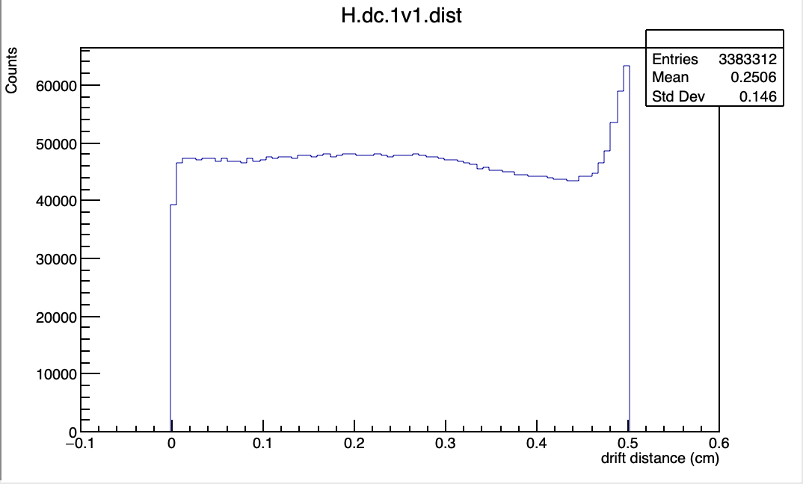
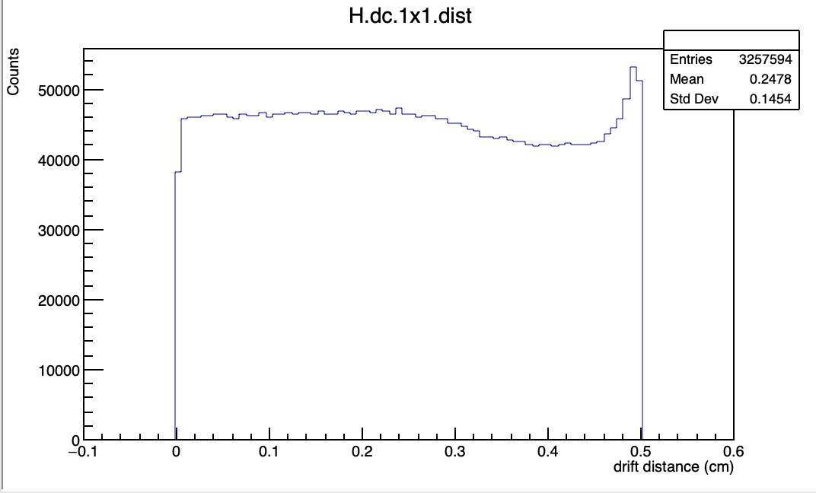
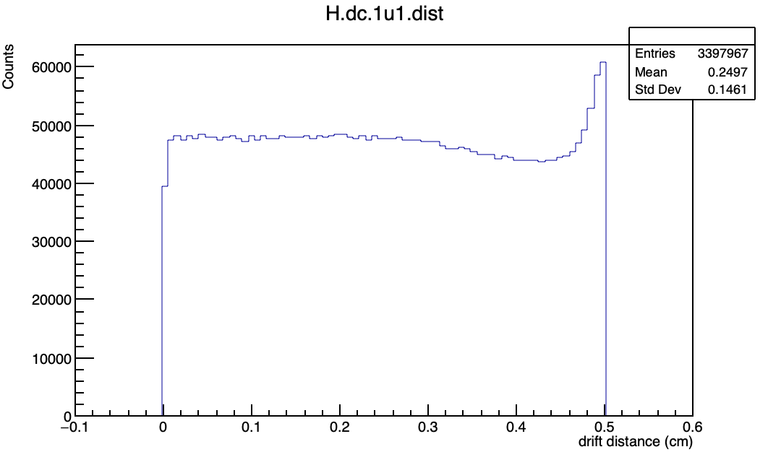
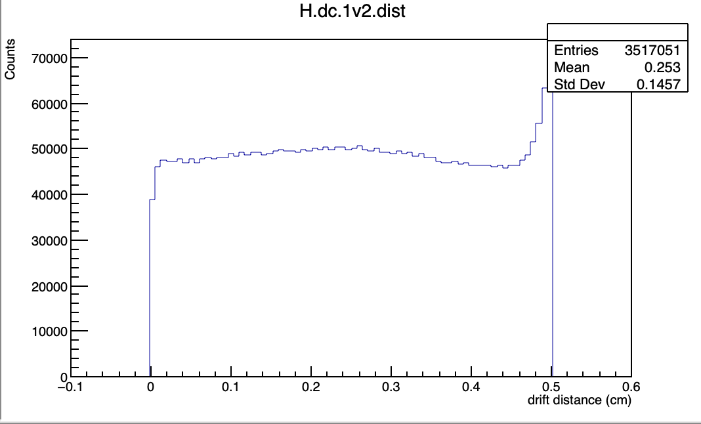
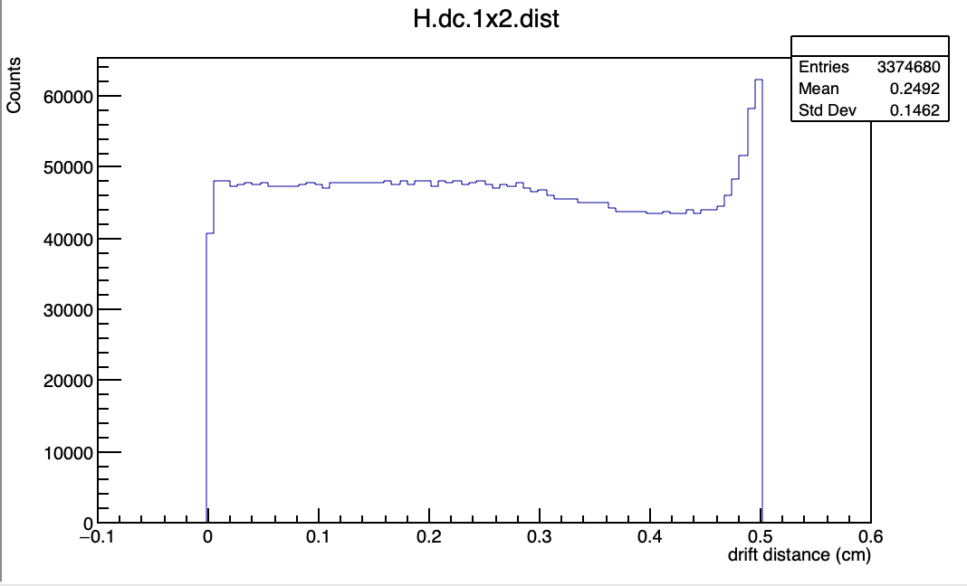
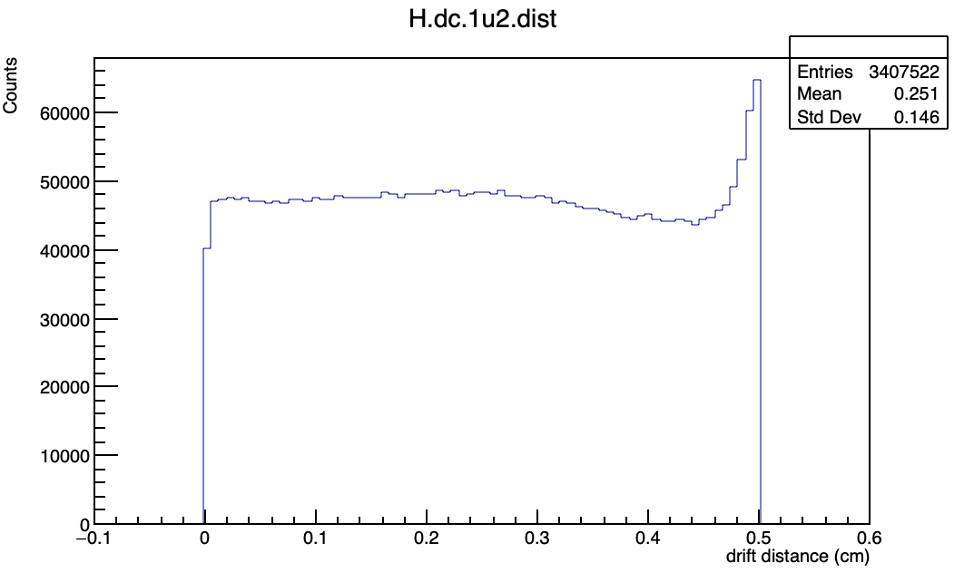
RUN 4402 Calibration Results

Slide 4
Calibrating using Coincidence Runs
Analyzed the focal plane position of eight different coincidence runs to determine if the focal plane position changed:
If it changes position, will need to merge all data files
If it doesn’t change, pick RUN# with most data
The focal plane refers to the “imaginary” plane separating DC1 and DC2 →chosen such that the focal point of the spectrometers’ optics is focused at the origin of the focal plane
The DC planes are separated by 80 cm measuring from the origin of the focal plane
Particles are focused onto the focal plane and particles coinciding with the central spectrometer momentum are focused at the origin

Slide 5
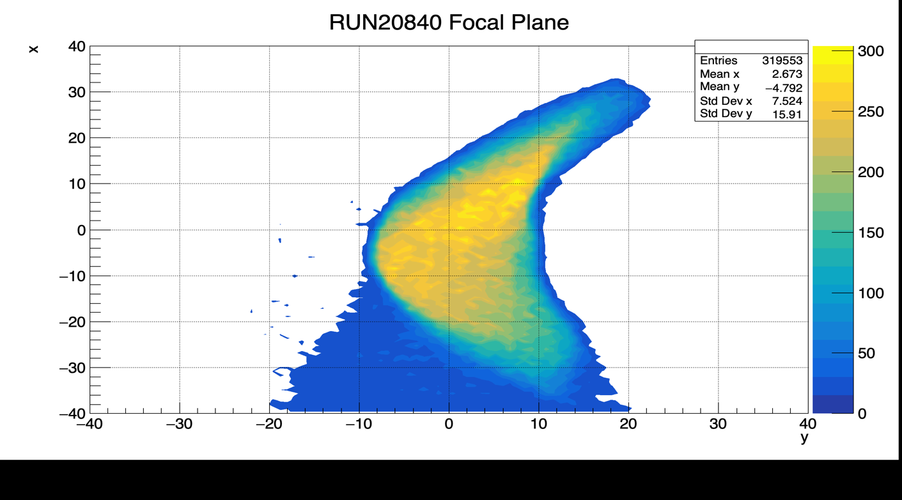
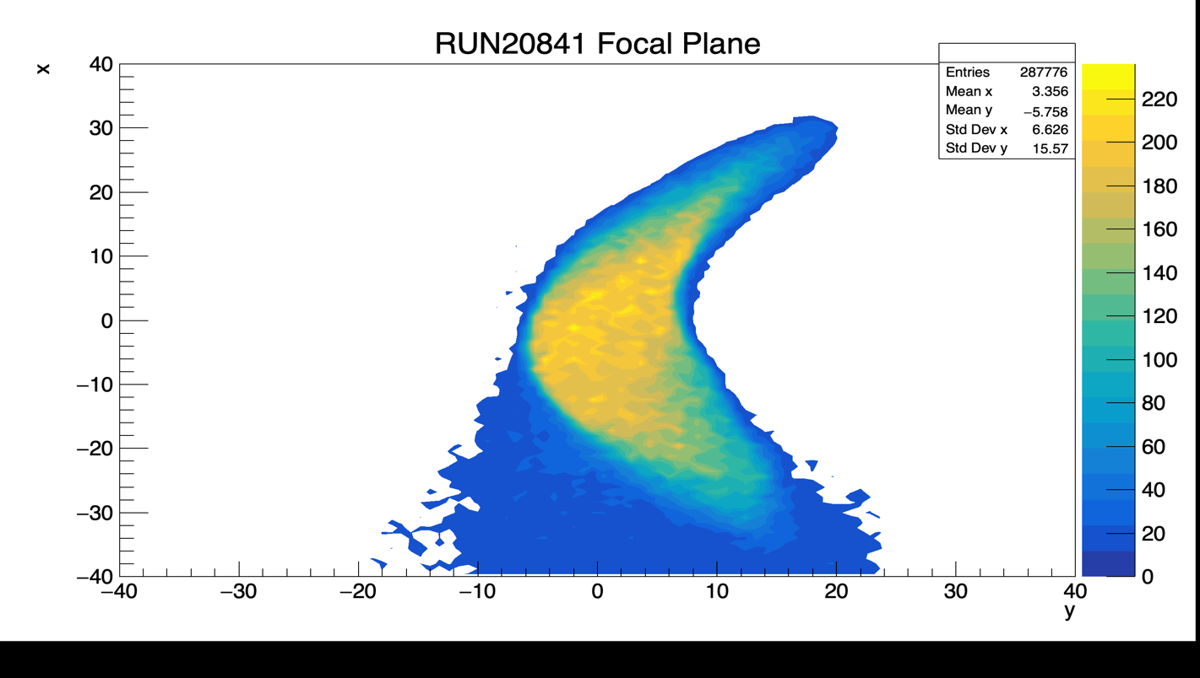
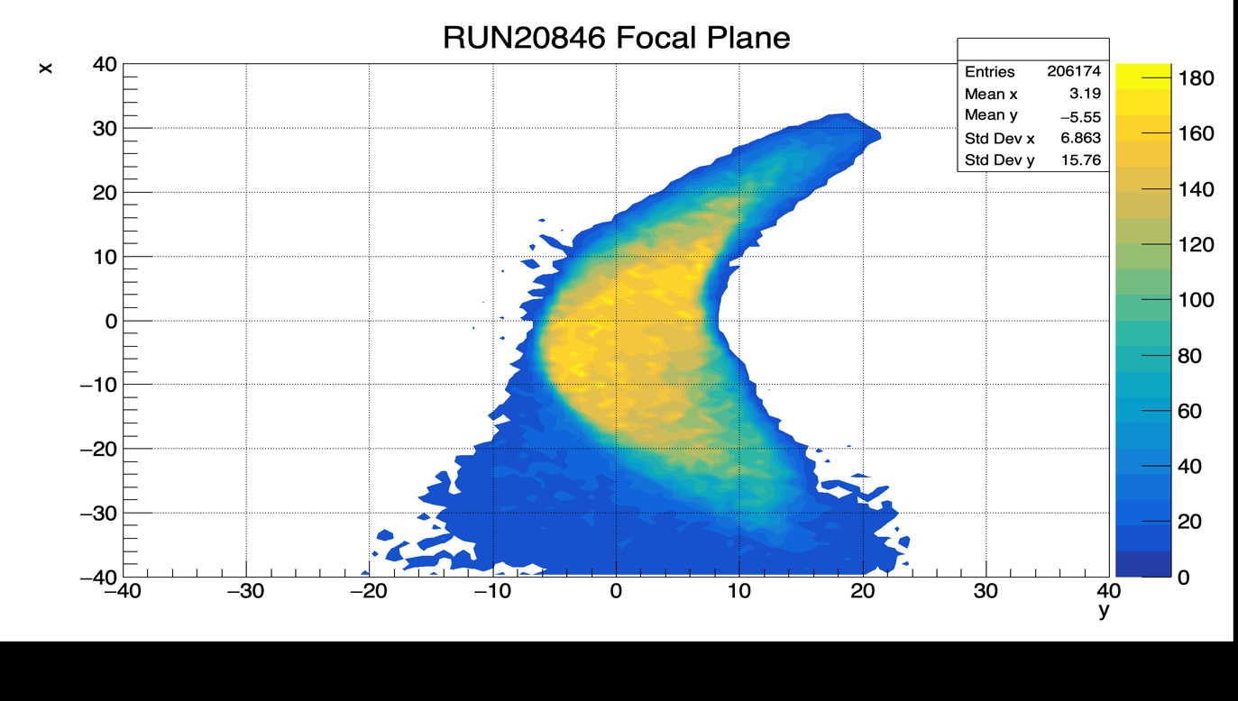
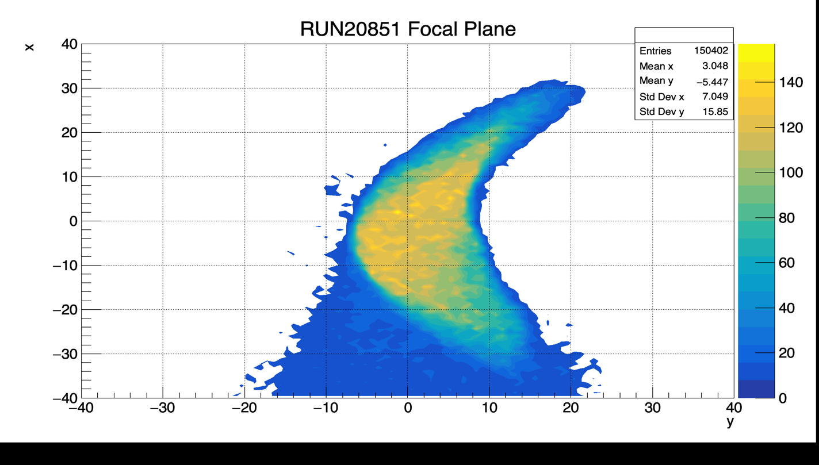

Slide 6
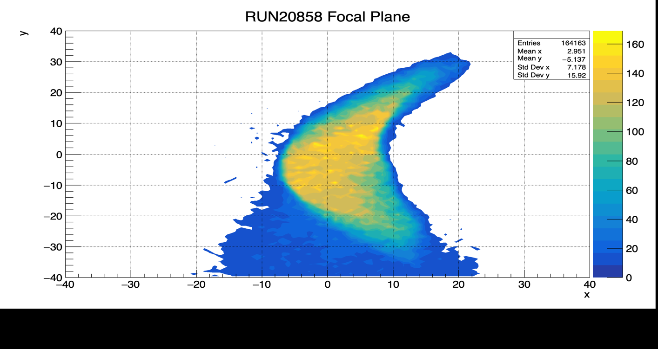
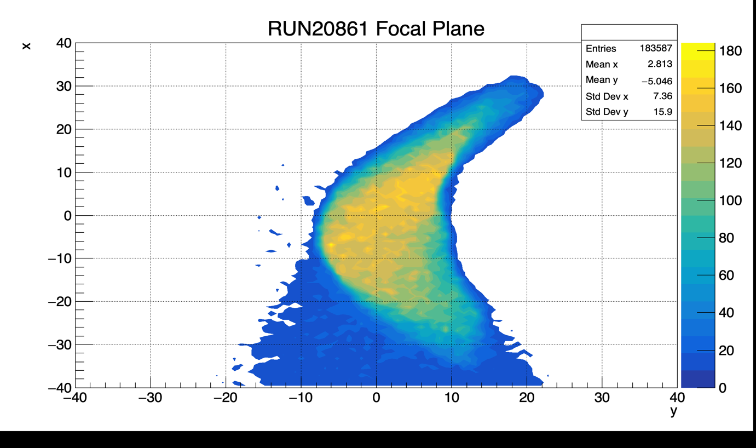
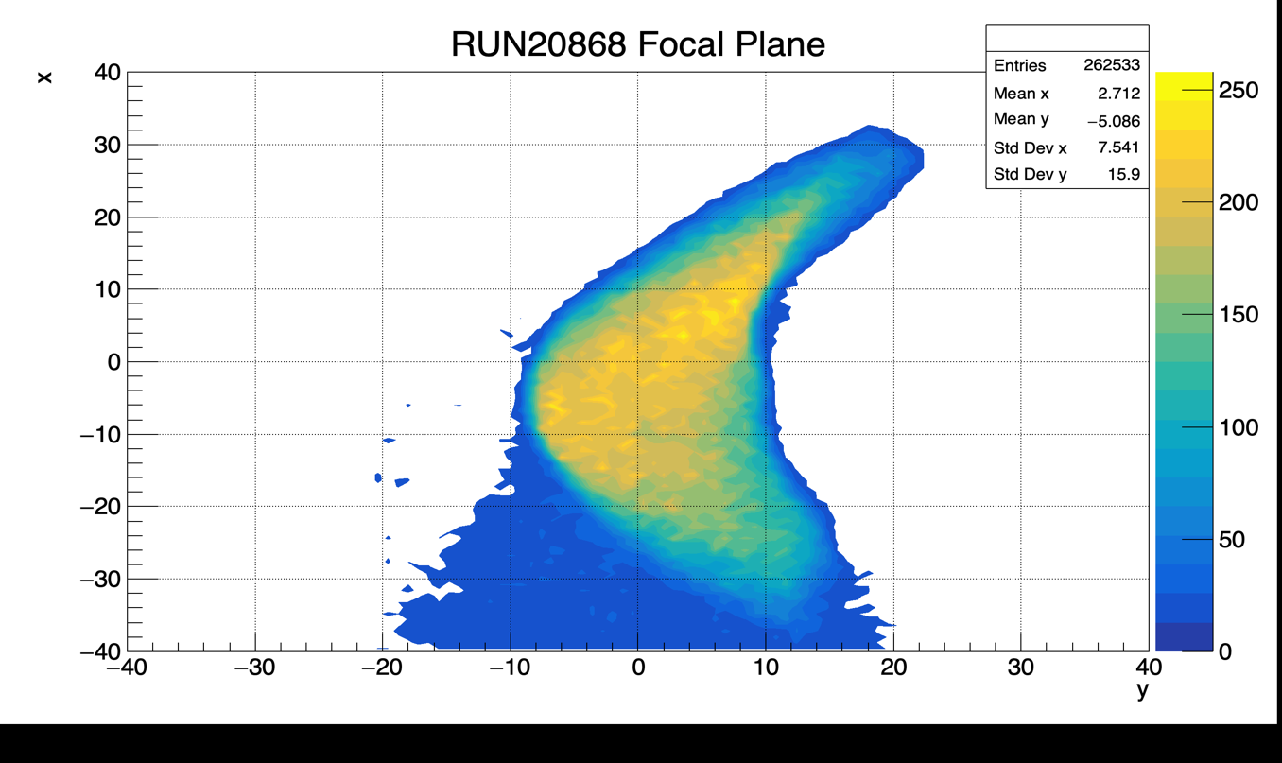
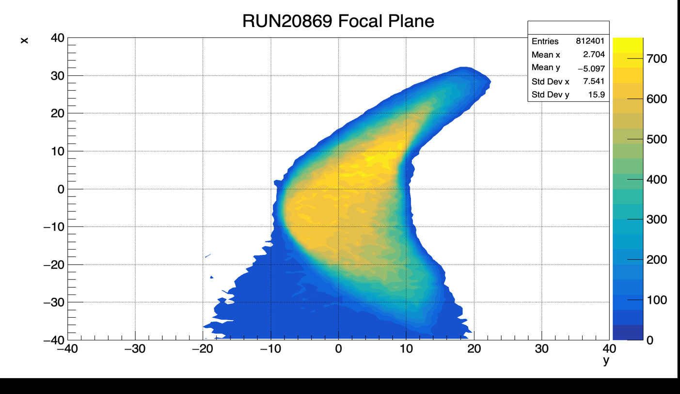
x
y

Slide 7
RUN 20869
Hall Coordinate System Front-view
Focal plane position ~ same → Use file with most physics events
+y_{h} (pointing towards ceiling)
HMS
SHMS
θc
+x_{h}
+z_{h} (pointing towards hall)
HMS Coordinate System
+y
(Pointing towards ground)
+x
z- axis aligned with the spectrometer central ray rotated by the central spectrometer angle θc

Slide 8
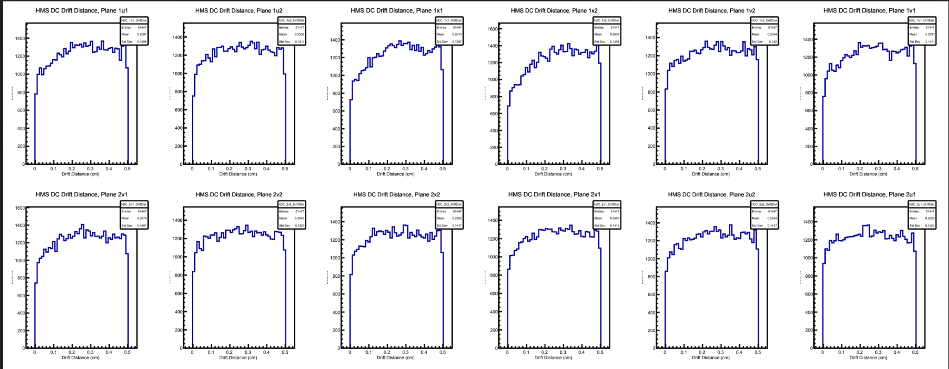
Testing Calibration Parameters
Checked using deuteron runs of 120, 800, and 900 MeV missing momentum
RUN 20871 (pm_120)

Slide 9
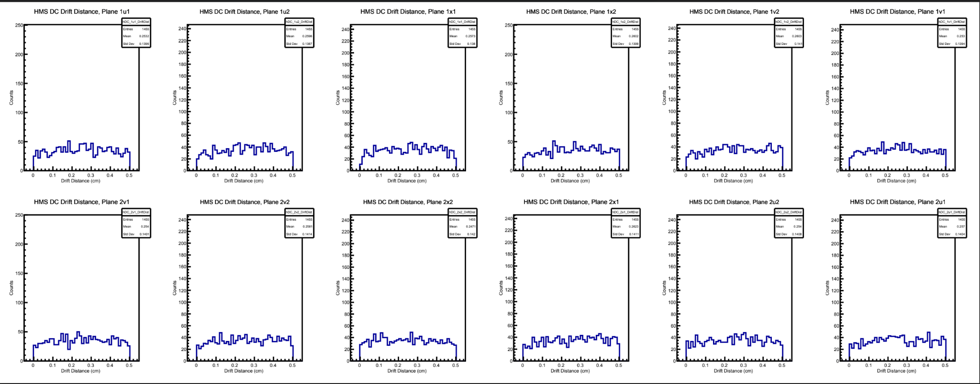
RUN 20951 (pm_800)

Slide 10
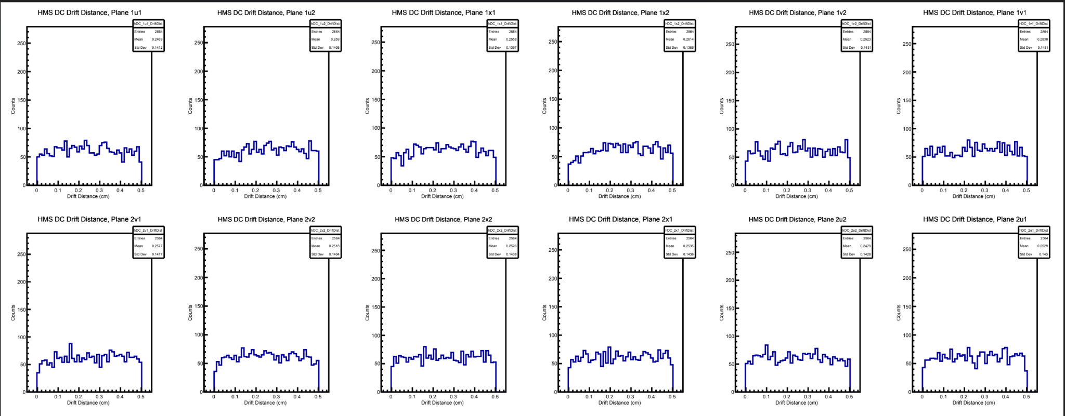
RUN 21024 (pm_900)

Slide 11
Next Week’s Goals
Get access to Simulation program
Use the Monte Carlo simulation (SIMC) to simulate RUNS → Compare simulated data to actual data

